Slide 1
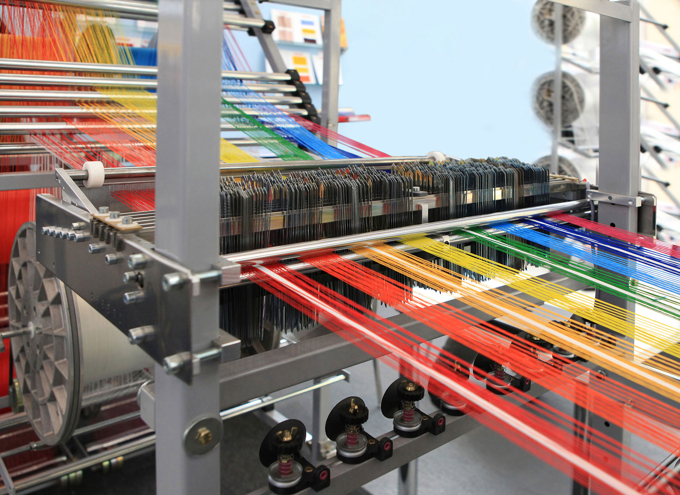
TEXTILE MANAGEMENT SYSTEM
Group 2:-
Sumanth Mohan- C0752365
Dhaval Vakil- C0752581
Abhishek Rangra- C0755154
Shubham Nanda- C0
Mahrshi Bhupesh Mahadevwala- C0

Slide 2
Textile Management System
Wholesaler Textile company which sells different types of processed cloth to the small companies.
The company is a wholesale and manufacturing unit which manufacture cloth of different types of materials based on the company’s requirement. Each ordered cloth from customer is recorded into database and an invoice is generated based on the order.

Slide 3
Types of Manufactured cloth: -
Silk
Wool
Cotton
Nylon
Fiber

Slide 4
Characteristics or Attributes of the System
Machine_ID
Loom_ID
Employee_ID
Cloth_Type
Comapany_ID
Order_ID
Product_ID
Price
Quantity
Total_Amount

Slide 5
Overview of Company and Products
This company deals with production of textile goods. This project aims at to monitor all process in the company, like production, manufacturing, purchase of raw materials, production of goods, shipment and bills. As these works are done manually at the company at present it takes a lot of time to complete the work. The main goal of this project is to reduce manual works, increase the processing speed and ensure reliability of data. All process needed for the textile management is recorded for providing good information to the concern.

Slide 6
Customer Sales Invoice:
Invoice-Id | Order-Id | Customer-Id | Product-Id | Cloth-Type | Date | Quantity | Discount | Price | Total-Amount
In01 | Or01 | 001A | CT101 | silk | 2019-12-01 | 25 | 3% | 400 | 9700
 |  |  | CT102 | wool | 2019-12-01 | 30 | 1% | 200 | 11000
 |  |  | CT103 | fabric | 2019-12-01 | 10 | 2% | 300 | 9000
 |  |  | CT104 | nylon | 2019-12-01 | 5 | - | 200 | 1000
 |  |  |  |  |  |  |  |  | 29700/-

Slide 7
Entity & Attribute Identification:
Entity
Invoice_ID
Customer_ID
Product_ID
Date
Order_Id

Slide 8
Attributes
Cloth_Type
Date
Quantity
Discount Price
Total-Amount

Slide 9
Unique Identifier
Invoice_Id
Order_Id
Customer_Id
Product_Id

Slide 10
Conceptual Design

Slide 11
ER Diagram:
1. Create an ER diagram based on the customer invoice. Only include the entities identified in the entity & attribute identification:
Entities
Attributes
Name
Data type (optional)
Size (optional)
Unique Identifiers
Named Relationships

Slide 12
Optionality and Cardinality
Foreign Keys
Relationship Strength
ERD language for the relationships

Slide 13
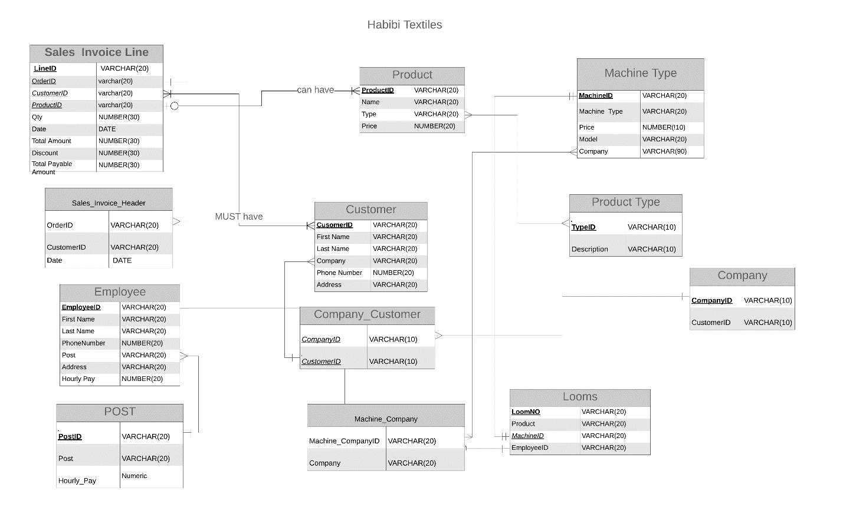
2. Create a second ER diagram that resolves many-to-many relationships

Slide 14
Logical Model
Normalization & Relational Schema:
1. Create a document called "Database Normalization"
a. Normalize your database to 3NF
b. Modify the ER diagram if necessary
2. Include a relational schema for each entity

Slide 15
Physical Model
Physical Table Representation:
Convert the logical model to a physical model using a table format
a. Create a table for each physical database table

Slide 16
TABLES CREATION
Table Post
CREATE TABLE "Post" (
"PostID" VARCHAR(20),
"Post" VARCHAR(20) NOT NULL,
"Hourly_Pay" NUMERIC(20) CHECK(Hourly_Pay > 0)
PRIMARY KEY(PostID) );

Slide 17
Table Employee
CREATE TABLE "Employee" (
"EmployeeID" VARCHAR(20),
"First Name" VARCHAR(20) NOT NULL,
"Last Name" VARCHAR(20),
"PhoneNumber" NUMERIC(20) NOT NULL,
"PostID" VARCHAR(20) NOT NULL,
"Address" VARCHAR(20)
PRIMARY KEY (EmployeeID)
FOREIGN KEY (PostID) REFERENCES Post(PostID));

